Slide 1



CS210 - Data Structures and Algorithms 1
Dr. Natalie Culligan
Natalie.Culligan@mu.ie

Slide 2
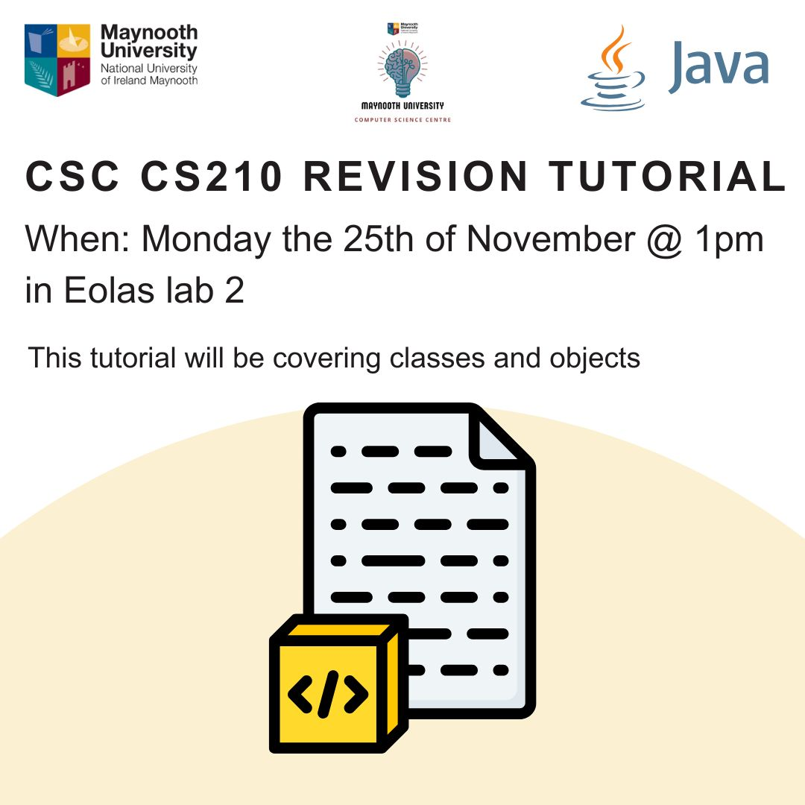

Slide 3

Recursion
To understand recursion, we must understand recursion

Slide 4
Recursive Methods
Consider the recursion class shown here
What will happen when we run this code?
What makes the copyMethod() recursive?
public class Recursion {
public static void main(String args[]) {
copyMethod();
}
public static void copyMethod(){
System.out.print("Copy of a ");
copyOfA();
}
}

Slide 5
What happens?
As you’d expect, the main method calls copyMethod(), which prints out “Copy of a” and calls copyMethod(), which prints out “Copy of a “ and calls copyMethod(), which prints out “Copy of a” and calls copyMethod(), which prints out “Copy of a “ and calls copyMethod(), which prints out “Copy of a” and calls copyMethod(), which prints out “Copy of a “ and calls copyMethod(), which prints out “Copy of a” and calls copyMethod(), which prints out “Copy of a “ and calls copyMethod(), which prints out “Copy of a” and calls copyMethod(), which prints out “Copy of a “ and calls copyMethod()…..
…until the program crashes!

Slide 6

Recursion
Recursion happens when a method calls itself
We can use it when a complicated problem can be broken down into a simpler problem of the same type
We can call the same method on the simpler problems and use the results to solve the bigger problem

Slide 7
Iterative example
Let’s look at a program that calculates the factorial of a number using an ordinary loop
We know that the factorial of 5, 5! is:
factorial(5) = 1 x 2 x 3 x 4 x 5 = 120
public static int factorial( int N ) {
int product = 1;
for ( int j=1; j<=N; j++ )
product = product * j;
return product;
}

Slide 8
Recursive example
However, we can do the same thing, using recursion
Why are we able to use recursion?
Because factorial(5) = factorial(4) x 5 and factorial(4) = factorial(3) x 4
Remember - recursion can be used to figure out the answer to the smaller problem first and use this to figure out the answer to the bigger problem
public static int factorial( int N ) {
return N * factorial( N-1 ) ;
}

Slide 9
Recursion
factorial(5) = factorial(4) x 5 and
factorial(4) = factorial(3) x 4
factorial(3) = factorial(2) x 3
factorial(2) = factorial(1) x 2
factorial(1) = 1 x 1
Remember – we don’t get a answer for each of these stages like we do with the iterative example – instead we build up an equation to solve, until we reach the “bottom” – the base case.
What do we mean by base case?

Slide 10

Base case
There’s a flaw with the previous piece of code
It goes on forever! (Until it crashes)
We need to get it to stop at some point
In order to stop, all recursive methods must have base case where the answer is known, and we don’t call the recursive method again

Slide 11
Base case
When do we want our algorithm to stop breaking the problem into smaller problems?
When we reach factorial(1)
The answer to factorial(1) will always be 1
We can set this as the base case using an if statement:
public static int factorial( int N ) {
if ( N == 1 )
return 1;
else
return N * factorial( N-1 );
}

Slide 12
to calculate factorial(5):
factorial(5) = 5 x factorial(4)
= 5 x ( 4 x factorial(3) )
= 5 x ( 4 x ( 3 x factorial(2) ))
= 5 x ( 4 x ( 3 x ( 2 x factorial(1) )))
= 5 x ( 4 x ( 3 x ( 2 x 1 )))
= 5 x ( 4 x ( 3 x 2) )
= 5 x ( 4 x 6 )
= 5 x 24
= 120

Slide 13
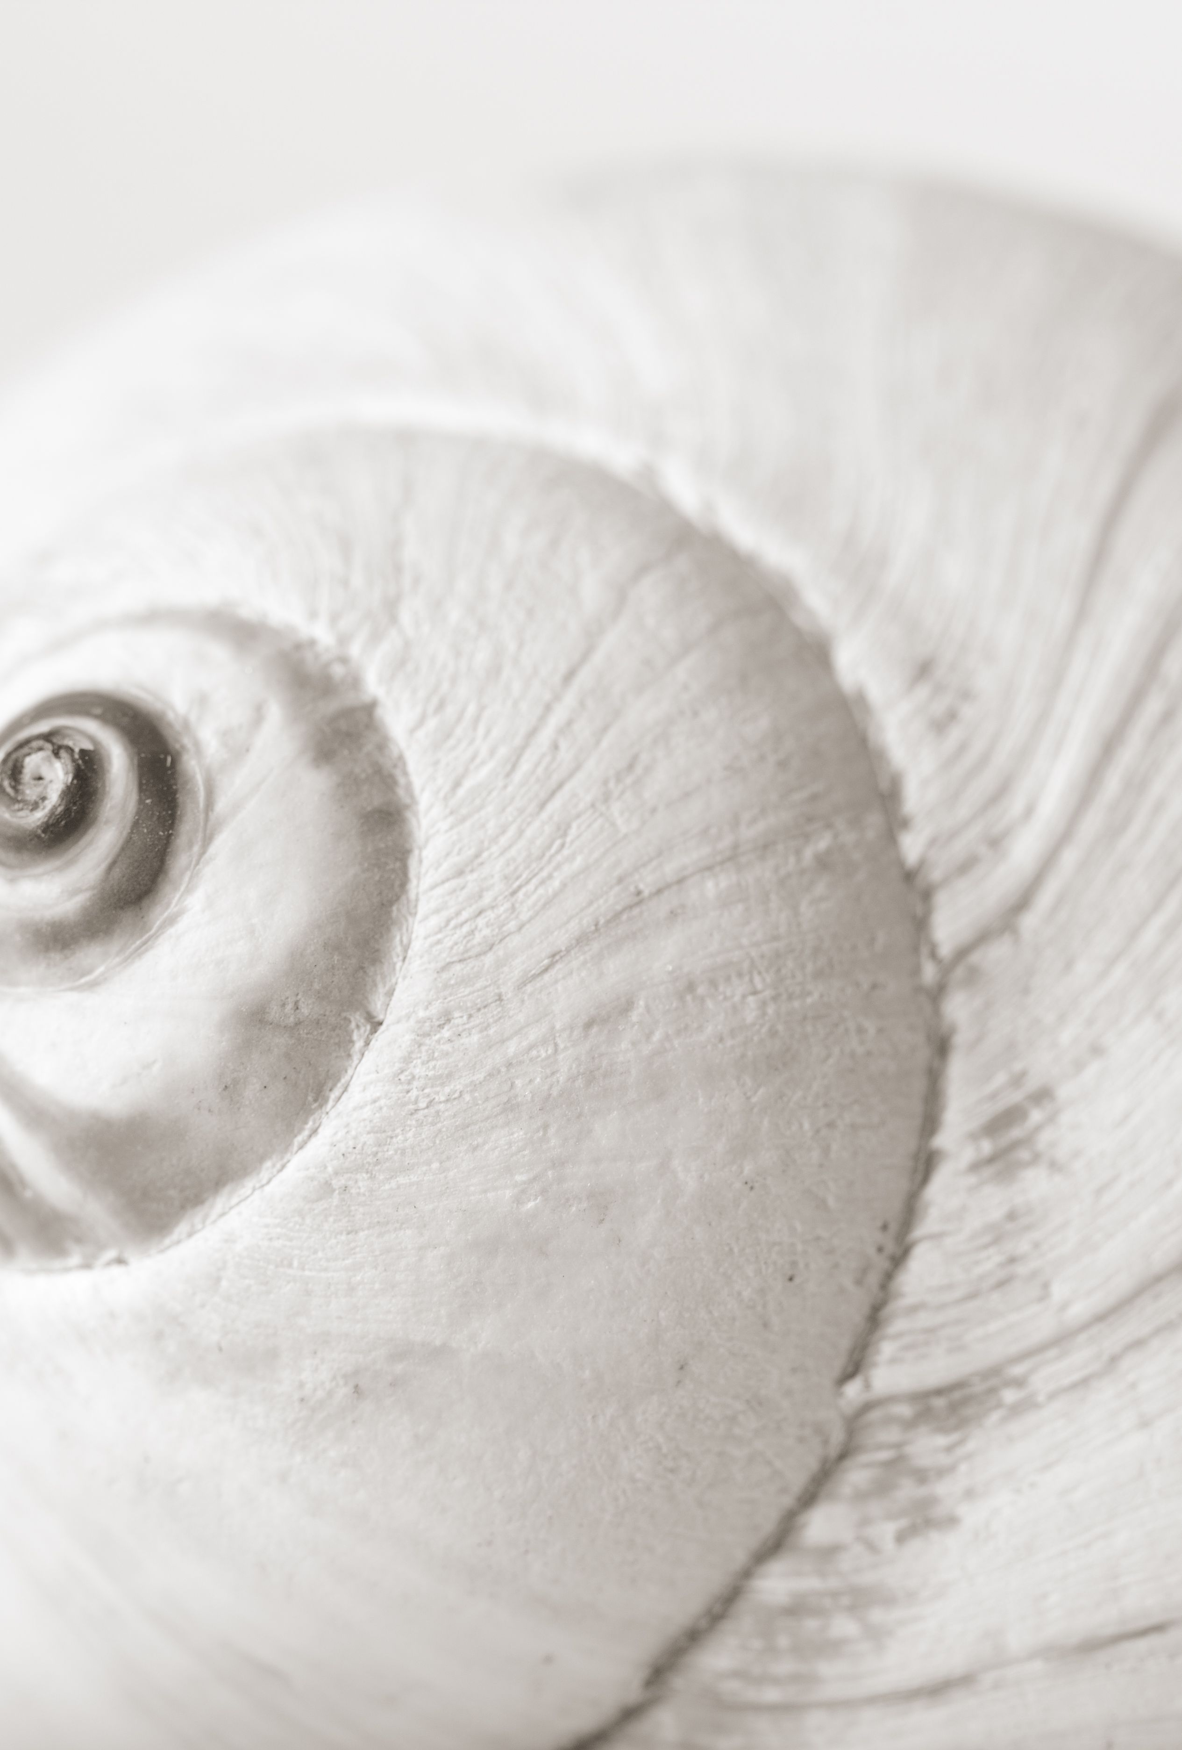
Recursion
The method keeps calling itself until it reaches the base case and then it filters back up
Recursion can be used to simplify a problem conceptually
It also reduces the amount of code needed
The characteristics of a recursive method are
It calls itself
When it calls itself, it does so to solve a smaller problem
There’s some version of the problem that is simple enough that the routine can solve it and return without calling itself

Slide 14

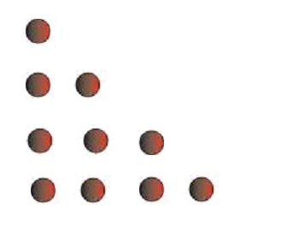
Example: Triangular Numbers
How can we find the n^{th} term of this sequence?
[ 1 3 6 10 15 21 … ]
Each time the n^{th} term is obtained by adding n to the term before
The numbers are called triangular numbers because they can be visualized as a triangular arrangement of numbers
The 3rd term is the total number of items in three rows etc.
Total = 6
Total = 10

Slide 15
Example
Say we want to get the fourth term we have to add
4 +3 +2 + 1 = 10
We can do this with a while loop:
public static int triangle (int n){
int total = 0;
while(n > 0){
total=total+n;
n--;
}
return total;
}

Slide 16
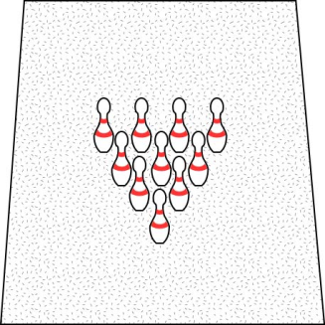
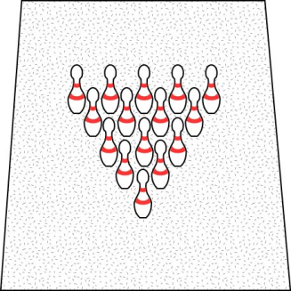
Algorithm
4th Term
5th Term
Therefore, the following is true:
pins in N rows = pins in row N + pins in N-1 rows
Here is the algorithm for recursive triangular numbers:
Triangle( 1 ) = 1
Triangle( N ) = N + Triangle( N - 1 )

Slide 17
Triangle(5)
triangle(5) = 5 + triangle (4)
= 5 + ( 4 + triangle (3) )
= 5 + ( 4 + ( 3 + triangle (2) ))
= 5 + ( 4 + ( 3 + ( 2 + triangle (1) )))
= 5 + ( 4 + ( 3 + ( 2 + 1 )))
= 5 + ( 4 + ( 3 + 3) )
= 5 + ( 4 + 6 )
= 5 + 10
= 15
So, to calculate triangle(5):

Slide 18
Fibonacci Series
public static long fibonacci(int n) {
if (n == 1) return 1;
if (n == 2) return 1;
return fibonacci(n-1) + fibonacci(n-2);
}
The Fibonacci series is as follows:
1, 1, 2, 3, 5, 8, 13…
Each term is calculated by the sum of the two terms before it
Notes:
check

Slide 19
The Efficiency of Recursion
Recursive implementation of fib is straightforward
First few calls to fib are quite fast
For larger values, the program pauses a long time between outputs
It turns out that using recursion to compute Fibonacci numbers is terrible!!
REMEMBER: recursion can simplify code but is not always more efficient
Why is this?

Slide 20
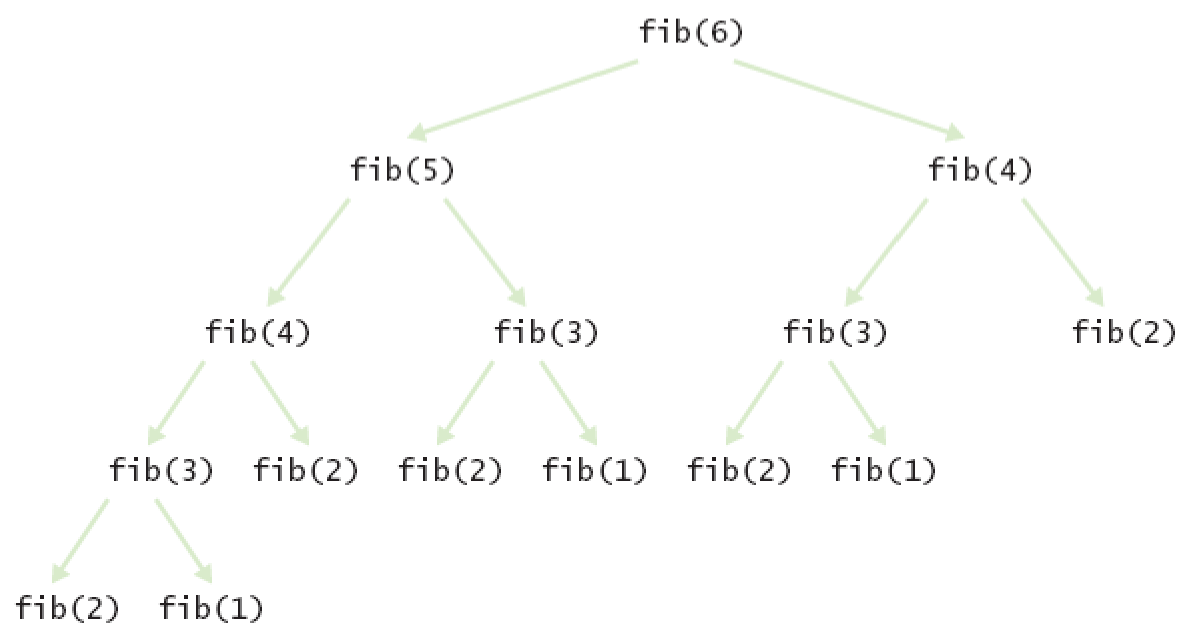
Call tree for computing fib(6)
Do you notice anything inefficient about this?
Notes:
How many time do we calculate fib(2)?

Slide 21

The efficiency of recursion
Method takes a long time because every level doubles the number of recursive calls
The computation of fib(6) calls fib(3) three times and fib(2)five times!
A recursive method should not call itself more than once per input
If we want to use recursion, without exponential increase in number of method calls, we can use dynamic programing

Slide 22
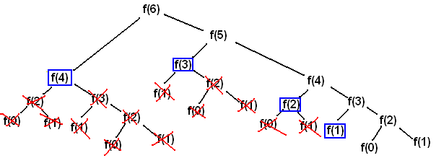
Dynamic programming
Dynamic programming (also known as dynamic optimization) is a method for solving a complex problem by breaking it down into a collection of simpler subproblems, solving each of those subproblems just once, and storing their solutions
The next time the same subproblem occurs, instead of recomputing its solution, we simply look up the previously computed solution, thereby saving computation time at the expense of increasing storage space

Slide 23
Dynamic programming
Time Com­plex­ity: O(n) , Space Com­plex­ity : O(n)
To decide whether prob­lem can be solved by apply­ing Dynamic pro­gram­ming we check for two prop­er­ties.
The problem involves over­lap­ping sub-problems that need to be solved again and again. In dynamic pro­gram­ming we solve these sub prob­lems only once and store it for future use
If a big prob­lem can be solved by using the solu­tions of the sub prob­lems then we say that prob­lem also has an opti­mal sub­struc­ture prop­erty

Slide 24
Dynamic Programming
Bottom up:
Is iterative
Take the simplest/smallest value, and build up to our final answer
Dynamic programming can be:
Bottom up
OR
Top down
Top down:
Is recursive
We consider the solution and describe it as a combination of the results of a series of subproblems

Slide 25
Dynamic programming: bottom up
Bottom-Up solu­tion for Fibonacci Series:
public int fibBU(int x) {
int fib[] = new int[x + 1];
fib[0] = 0;
fib[1] = 1;
for (int i = 2; i < x + 1; i++) {
fib[i] = fib[i - 1] + fib[i - 2];
}
return fib[x];
}
Notes:
Is this recursive? Why?
We can actually use this to print out the entire fibonnaci sequence, if we add a print statement

Slide 26
Dynamic programming: Top-DOwn
Top-Down recursive approach, involving filling up an array which lies outside the recursive method:
public int fibTD(int n) {
if(n==0) return 1;
if(n==1) return 1;
if(fib[n]!=0){
return fib[n];
}else{
fib[n] = fibTD(n-1) + fibTD(n-2);
return fib[n];
}
}

Slide 27
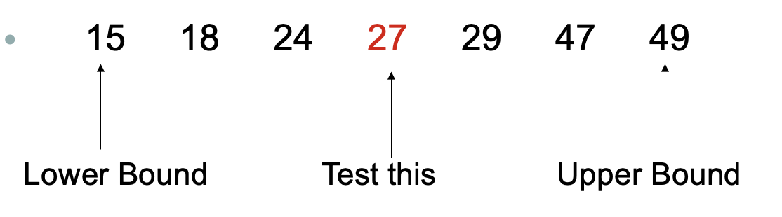
Remember Binary Search?
We keep dividing our search space and therefore need to keep track of the bounds
Upperbound
Lowerbound
If the number is bigger than 27 then 27 is the new lower bound

Slide 28
Recursive Binary Search
The binary search for arrays keeps dividing the array in half and then selecting the half where the desired cell could possibly be
Instead of using a loop as before, we can simply call the search function on the half of the array
The find method makes the initial call to search the whole array using recursive find
public int find(long searchKey){
return recFind(searchKey, 0, nElems-1);
}

Slide 29
Recursive Binary Search
private int recFind(long searchKey, int lowerBound,
int upperBound){
int middle;
middle = (lowerBound + upperBound ) / 2;
if(a[middle]==searchKey)
return middle; // found it
else if(lowerBound > upperBound)
return -1; // can't find it
else { // divide range
if(a[middle] < searchKey) // it's in upper half
return recFind(searchKey, middle+1, upperBound);
else // it's in lower half
return recFind(searchKey, lowerBound, middle-1);
} // end else divide range
}
} // end recFind()

Slide 30
Recursive Binary Search Method
Call with lowerbound=0 upperbound=15
Lowerbound=0
Upperbound=15
Lowerbound=0
Upperbound=6
Lowerbound=0
Upperbound=2
Lowerbound=2
Uppperbound=2
Found it at 2
Return 2
Return 2
Return 2
Return 2
Return 2

Slide 31

Divide and Conquer
Recursive binary search is an example of the divide and conquer approach
The big problem is divided into two smaller problems and each one is solved separately
These are then divided into even smaller problems etc.
The process continues until you get to the base case which can be solved easily with no further division
The answer is then filtered back through all the recursive method calls

Slide 32
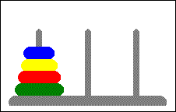
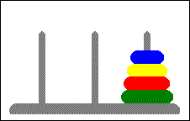
Towers of Hanoi
In the late Victorian era, a toy came out that was based on an idea of a French mathematician, Edouard Lucas. The toy consisted of a set of three rods and a set of discs
The idea is to move all the discs one at a time without ever placing a disc on top of a smaller one
Starting Position
Ending Position
Notes:
here

Slide 33
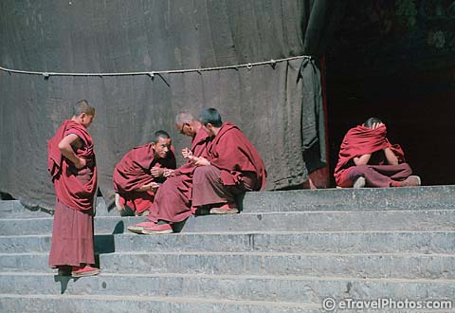
Legend (OR marketing)
Somewhere in Tibet, in a remote temple, monks labor day and night to transfer 64 golden disks from one of three diamond-studded towers to another
When all the discs have been correctly moved, the universe will end
Do we need to be worried?
Remember Big O Notation
The problem is exponential O(2^{n})
At a second per move, it will take the monks about five hundred trillion years

Slide 34
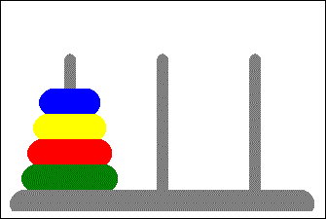
TOWERS OF HANOI

Slide 35
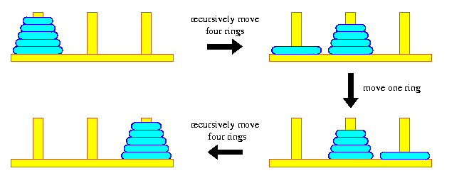
Recursive Algorithm
Lets call the initial tree-shaped arrangement of disks a tree and the smaller groupings subtrees
In order to transfer 5 disks, one of the intermediate steps involves a subtree of 4 disks
The creation of a subtree is the only way to transfer a larger disk from one tower to another

Slide 36
Recursive Algorithm
We can break the problem into smaller and smaller subtrees
Assuming there are n disks, the algorithm is
Move the subtree of the top n-1 disks from source rod to intermediate rod
Move the remaining largest disk from source rod to destination rod
Now solve moving the subtree from intermediate rod to destination rod
Keep calling the recursive algorithm for moving the smaller subtrees
What’s the base case? When you’re moving only one disk, you just move it, there’s nothing else to do

Slide 37
Java Implementation
public class TowersApp {
static int nDisks = 3;
public static void main(String[] args) {
doTowers(nDisks, 'A', 'B', 'C');
}
public static void doTowers(int topN,
char src, char inter, char dest) {
if(topN==1)
System.out.println("Disk 1 from " + src + " to "+ dest);
else {
doTowers(topN-1, src, dest, inter); // src to inter
System.out.println("Disk " + topN + // move bottom
" from " + src + " to "+ dest);
doTowers(topN-1, inter, src, dest); // inter to dest
}
}
}

Slide 38
Output
Disk 1 from A to C
Disk 2 from A to B
Disk 1 from C to B
Disk 3 from A to C
Disk 1 from B to A
Disk 2 from B to C
Disk 1 from A to C
How about those monks?
Put nDisks = 64 and what output do you get?

Slide 39
Palindromes
A palindrome is a phrase that reads the same forwards as backwards
You can also think about it as a string whose first half is a mirror image of its second half
“rats live on no evil star”
“Mr. Owl ate my metal worm”
N A V A N

Slide 40
Think Recursively!
How do we make the problem smaller?
Remove both the first and last characters
Remove a character from the middle
Most promising simplification: remove first and last characters
“AVA", is a palindrome too!
A word is a palindrome if
The first and last characters match, and
Word obtained by removing the first and last characters is a palindrome

Slide 41
Palindromes
If we have a palindrome like radar we can check if the first and last letters are the same
If they are not then it is not a palindrome
We now need to check the middle letters to see if they are a palindrome
Call the recursive method on the middle letters

Slide 42
Palindromes
To pick out the middle letters we can use the substring method
word.substring(1, word.length()-1);
The base case is when we have just one or two letters left and all the other letters have checked out
r a d a r
ada
d

Slide 43
Raising to a power
We can use recursion to raise a number to a power
For example, 2⁸ is 2 x 2 x 2 x 2 x 2 x 2 x 2 x 2
Do we really need to multiply these all out?
After we’ve calculated 2 x 2 x 2 x 2 we know we can just square it
But in order to get 2⁴ we only need to multiply 2 x 2 and then square that!
We can keep halving the problem
In fact we can figure out 2⁸ using just 3 multiplications instead of 7 – that is O(logn) instead of O(n)
2⁸
(2x2x2x2x2x2x2x2) =
(2x2x2x2) ² = 256
(2x2)⁴ = 256
2⁸ = 256

Slide 44
Raising to a power
In the previous example, the power was always even, so could be easily divided by two
If the power happens to be odd then we need to subtract one from the power, solve that, and then multiply it again to account for the power we subtracted
Base case is raising to the power of zero
int power(int k, int n) { // raise k to the power n
if (n == 0)
return 1;
else{
int t = power(k, n/2); //if odd, will discard remainder
if ((n % 2) == 0)
return t * t;
else
return k * t * t; //extra multiplication to make up
}
}

Slide 45
Mergesort

Slide 46
MErgesort
Our final example of recursion is Mergesort
This is more efficient than any of the other sorting algorithms we have considered, which were all O(n²)
Mergesort is O(n*logn)
If the number of items to be sorted is 10,000 then n² is 10 million whereas n*logn is only 40,000
If this many items can be sorted in a second by Mergesort, it would take nearly an hour using insertion sort

Slide 47


Merge Sort Example
The idea of mergesort is to divide an array in half and sort each half
They don’t have to be the same size!
Both halves are merged into a separate workspace array
Keeps comparing the lowest number in each of the halves before copying one into a workspace array

Slide 48
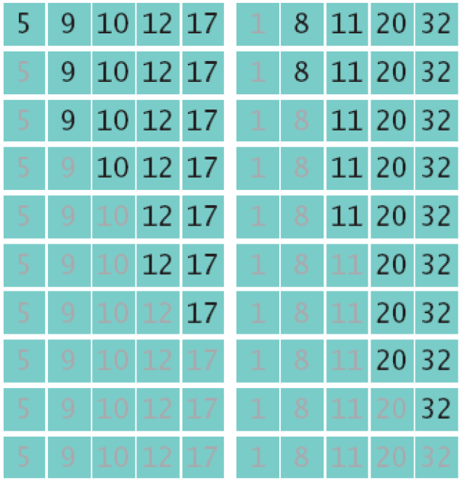
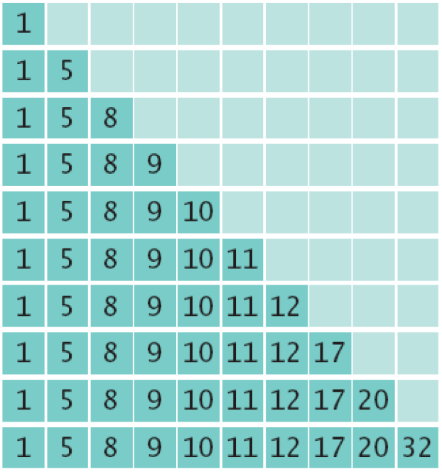
Merge Sort Example
Merge the two sorted arrays into a single sorted array
Workspace array

Slide 49
Merge example
Here are two lists to be merged:
First: (12, 16, 17, 20, 21, 27)
Second: (9, 10, 11, 12, 19)
Checkout 12 and 9
First: (12, 16, 17, 20, 21, 27)
Second: (10, 11, 12, 19)
Workspace: (9)
Checkout 12 and 10
First: (12, 16, 17, 20, 21, 27)
Second: (11, 12, 19)
Workspace: (9, 10)

Slide 50
Merge example
Checkout 12 and 11
First: (12, 16, 17, 20, 21, 27)
Second: (12, 19)
Workspace: (9, 10, 11)
Checkout 12 and 12
First: (16, 17, 20, 21, 27)
Second: (12, 19)
Workspace: (9, 10, 11, 12)

Slide 51
Merge example
Checkout 16 and 12
First: (16, 17, 20, 21, 27)
Second: (19)
Workspace: (9, 10, 11, 12, 12)
Checkout 16 and 19
First: (17, 20, 21, 27)
Second: (19)
Workspace: (9, 10, 11, 12, 12, 16)

Slide 52
Merge example
Checkout 17 and 19
First: (20, 21, 27)
Second: (19)
Workspace: (9, 10, 11, 12, 12, 16, 17)
Checkout 20 and 19
First: (20, 21, 27)
Second: ( )
Workspace: (9, 10, 11, 12, 12, 16, 17, 19)

Slide 53
Merge example
Checkout 20 and empty list
First: ( )
Second: ( )
Workspace: (9, 10, 11, 12, 12, 16, 17, 19, 20, 21, 27)

Slide 54
Java Implementation
In the following merge method
theArray is the array being sorted
first, second and upperBound define the edges of the two halves being sorted. first and second are incremented as items are copied into the workspace
first → second - 1 is the first half
second → upperBound is the second half
workSpace is the intermediate array into which values are copied
The values from workSpace are then copied back into theArray
First half
Second Half
5
6
1
7
2
9
4
5
first
second
upperBound

Slide 55
Java Implementation
public void merge(long[] workSpace, int first,
int second, int upperBound) {
int j = 0; // workspace index
int lowerBound = first;
int mid = second - 1;
int n = upperBound-lowerBound+1; // # of items
while(first <= mid && second <= upperBound) //halves not empty
if( theArray[first] < theArray[second] )
workSpace[j++] = theArray[first++];
else
workSpace[j++] = theArray[second++];
while(first <= mid) //check first half for remaining
workSpace[j++] = theArray[first++];
while(second <= upperBound) //check second half for remaining
workSpace[j++] = theArray[second++];
for(j=0; j<n; j++)
theArray[lowerBound+j] = workSpace[j]; //copy the workspace back
} // end merge()

Slide 56
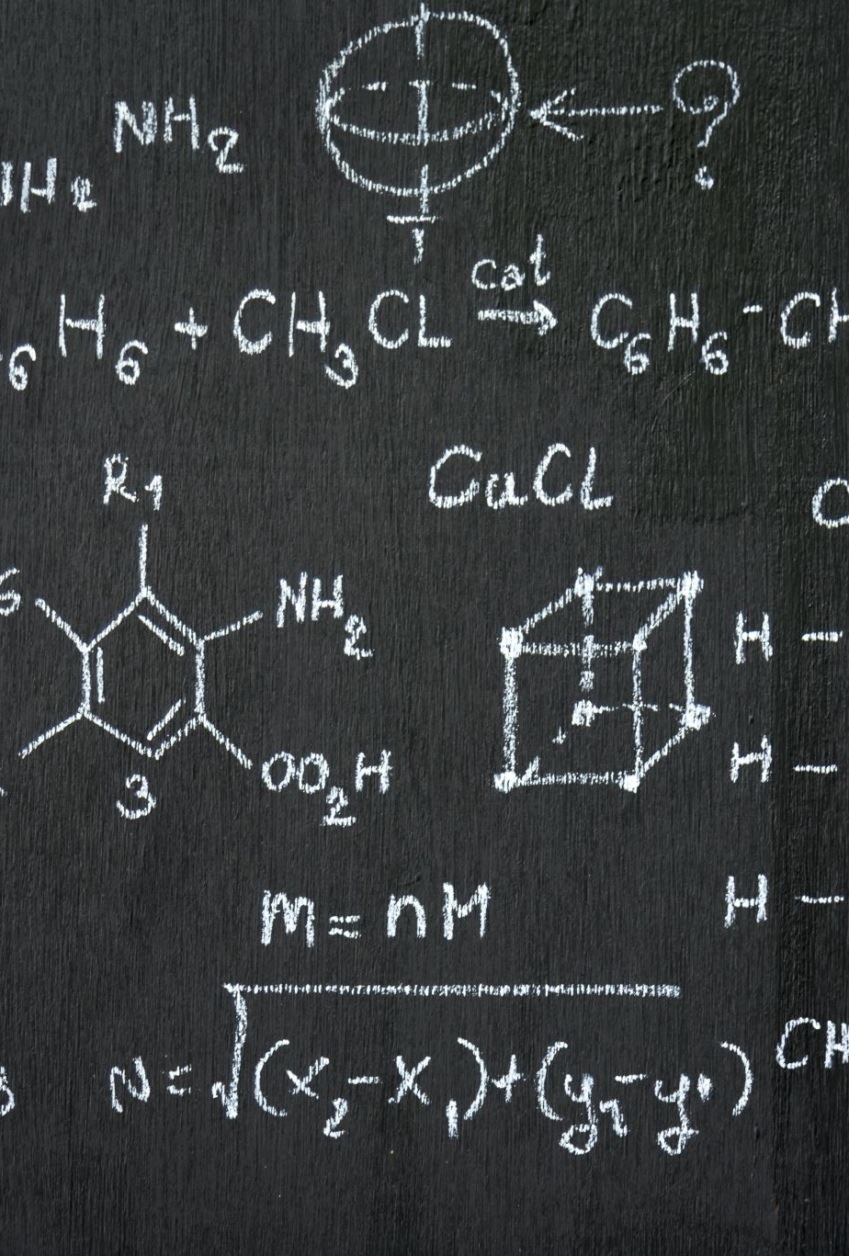
recMergeSort method
Computes the midpoint
Calls recMergeSort method on each of the halves
Calls merge method to merge the two sorted halves back together
Base case is when the range contains only one element (lowerBound==upperBound)
A single element is always sorted (obviously!) so it just returns itself

Slide 57
MergeSort

